Slide 1

Smoking-associated Differentially Expressed Methylations (DMRs) and predicting HIV prognosis and mortality
BMED 6517 – Machine Learning in Bio Sci
Deepali Kundnani | Paarth Parekh

Slide 2
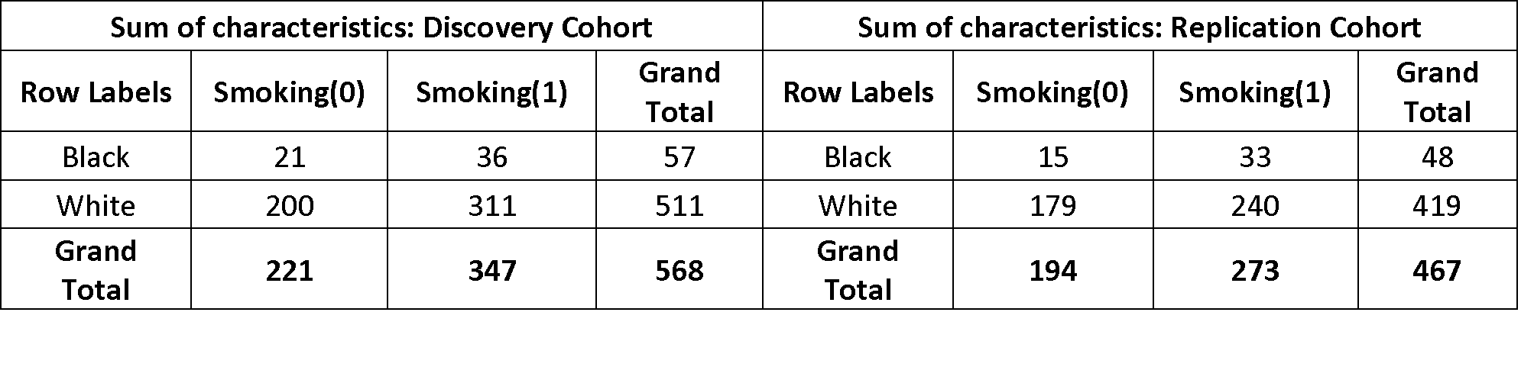
Data Description and Background
Samples: Veteran Aging Cohort Study (VACS) with male HIV patients
Data: Illumina Methylation Arrays HM450(450K probes)and EPIC(870K probes)
VACS index: estimates risk of mortality (outcome prediction)
Notes:
Instead of analyzing boxplots for every sample, we look at the descriptive statistical parameter distribution
And also look at unsupervised methods of feature extraction
408576 common found

Slide 3
Project Background
Smoking causes changes in the methylation of DNA
Prominent change is demethylation of aryl hydrocarbon receptor repressor(AHRR) in lymphoblast DNA
Smoking is also known to be associated with different diseases and poor outcomes in certain groups
Question: Is smoking associated with poor outcome for HIV patients?
Goal 1: Finding Smoking associated Differentially Methylated regions
Goal 2: Predicting poor outcome/mortality using VACs index for classification measure

Slide 4
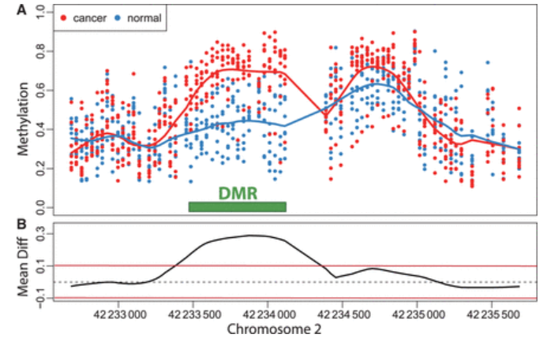
Supervised Feature Reduction - Differentially methylated regions
Methods Discussed in Class: Unpaired student t-test, Wilcoxon rank sum test, Signal to noise ratio
Modified tests for DMRs developed in recent years
Method/Tool | Purpose/underlying method | Year of publication | # of Citations
Bump hunting | LOESS smoothing | 2012 | 418
Comb - p | Correcting spatially correlated p-values | 2012 | 166
Aclust | adjusting site clustering | 2013 | 64
Probe lasso | Stouffer's method | 2015 | 67
DMRcate | Gaussian kernel smoothing | 2015 | 242
Notes:
https://rdrr.io/bioc/ChAMP/man/champ.DMR.html
Champ: https://bioc.ism.ac.jp/packages/3.3/bioc/vignettes/ChAMP/inst/doc/ChAMP.pdf
Relevant parameters: https://link.springer.com/article/10.1186/1756-8935-8-6/tables/1
Mentions analysis for Sequence and Array both: https://academic.oup.com/bfg/article/15/6/485/2555348
This group got more than 80% accuracy on 450K data: https://www.sciencedirect.com/science/article/pii/S2352396418303748 (what can we do different?)

Slide 5
DMRCate Parameters
DMRcate can work with Beta values or M values generated from Illumina Arrays
Beta values: M/(U+M+𝛼) (values obtained from NCBI Geodatasets)
M values: log equivalent of Beta values
Filtered 408576 probes common to both HM450 and EPIC Arrays
Annotating probes
design matrix specifying smoking status, needed for finding DMRs
FDR = 0.05
DMR settings
lambda to define the length of the sliding frame (we used 500 bp)
C=2, suggesting 250bp(lamba/C) as the length to look at both sides of each cpg to find correlating probes
Notes:
Instead of analyzing boxplots for every sample, we look at the descriptive statistical parameter distribution
And also look at unsupervised methods of feature extraction

Slide 6
DMRCate Results for Smokers vs Non Smokers
Discovery Cohort
872 Cpg sites (U/M = 526/346 = 0.6)
197 DMRs
Replication Cohort
1651 Cpg sites (U/M = 1336/315 = 0.8)
385 DMRs
There are 237 Cpg sites common in both Discovery and Replication Cohort, out of which top 51 are most significant in both cohorts
We concentrated on these 51 and 237 Cpg probes for further analysis
Notes:
Instead of analyzing boxplots for every sample, we look at the descriptive statistical parameter distribution
And also look at unsupervised methods of feature extraction

Slide 7
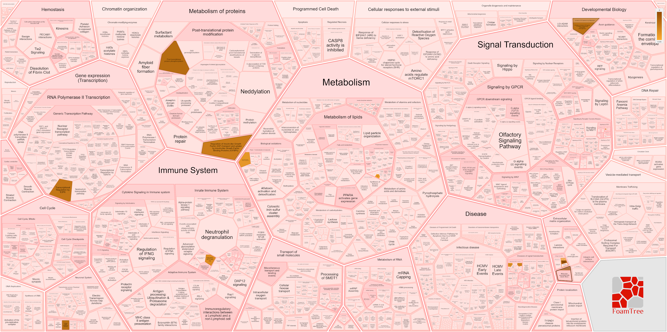
Pathway Analysis on Common DMRs using Reactome

Slide 8
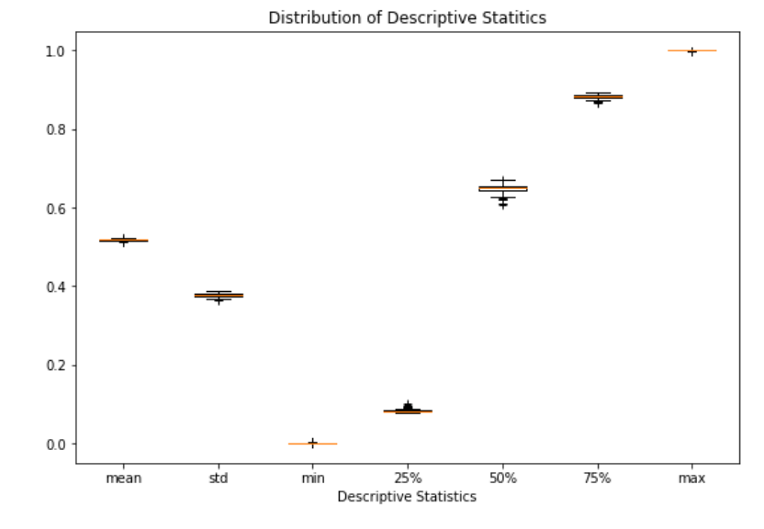
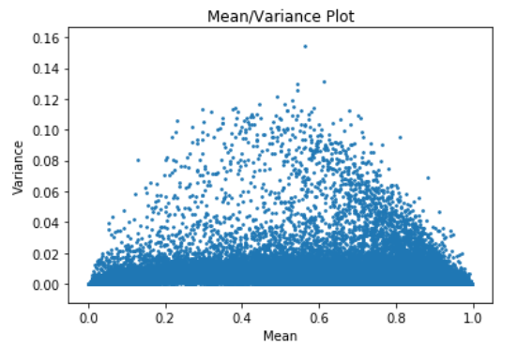
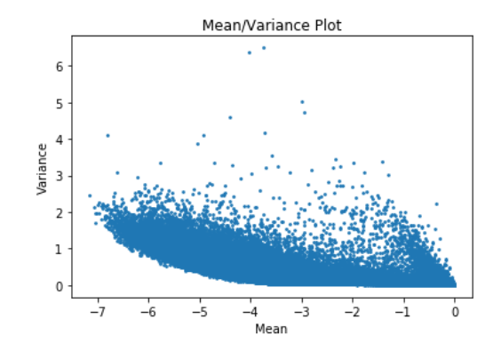
Data Distribution and Pre processing
Processed methylated data from Geodatabase
Log transformed the processed data
Notes:
The preprocessed data from the Geodataset which has been quantile normalized.
Instead of analyzing box plots for every sample, we look at the descriptive statistical parameter distribution
And also looked mean-var plot 1. processed data and 2.log transformed data.

Slide 9
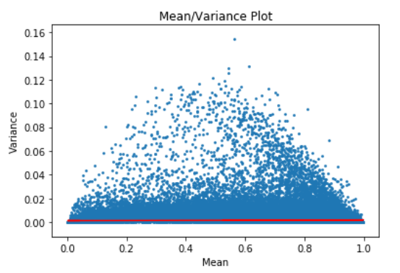
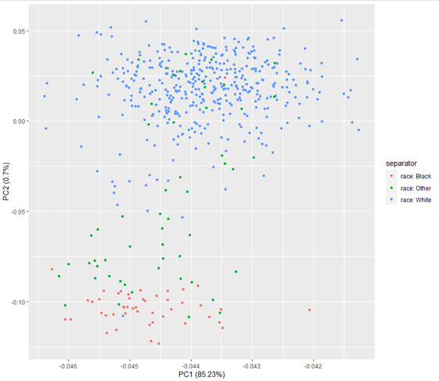
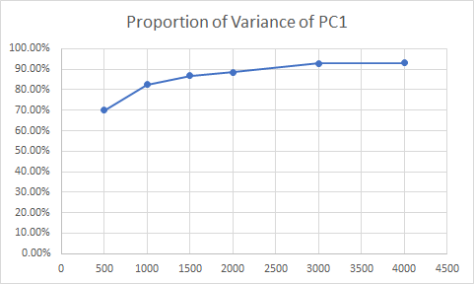
Unsupervised Feature Selection/Reduction
500 probes
1000 probes
2000 probes

Slide 10
Outcome Prediction
We found 231 common CPG sites between discovery and replication cohort which were differentially methylated between Smokers and Non-Smokers.
Using these CPG sites, we decided to train a model to predict the VACS index.
We received the VACS index for the discovery cohort from the authors.
The paper had used a classification method to indicate that VACS index above 50 were significant for poor outcomes (“1”) and below 50 VACS index were not (“0”).

Slide 11
Regression Methods
Linear Regression Results:
linear regression train score: 0.8851035472005736
linear regression test score: -0.3442118801418359
Ridge Regression Results:
ridge regression training score with alpha 0.01: 0.8770665738100606
ridge regression test score with alpha 0.01: 0.020947473652826343
ridge regression train score with alpha 1: 0.38854522257624274
ridge regression test score with alpha 1: 0.1531786434904806
Lasso Regression Results:
Lasso training score for alpha=1: 0.3350814835048658
Lasso test score for alpha=1: 0.19091077248637345
number of features used for training: 23
Lasso training score for alpha=0.01: 0.8062114158942004
Lasso test score for alpha =0.01: 0.19690794227247255
number of features used for training: for alpha =0.01: 173

Slide 12
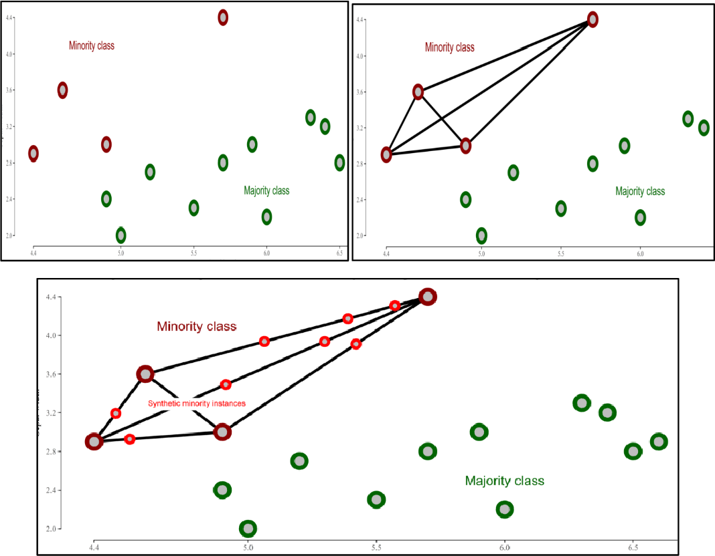
SMOTE
Classification using class-imbalanced data is biased in favor of the majority class.
The bias is even larger for high-dimensional data, where the number of variables greatly exceeds the number of samples
Synthetic Minority Oversampling TEchnique (SMOTE) is a very popular oversampling method.

Slide 13
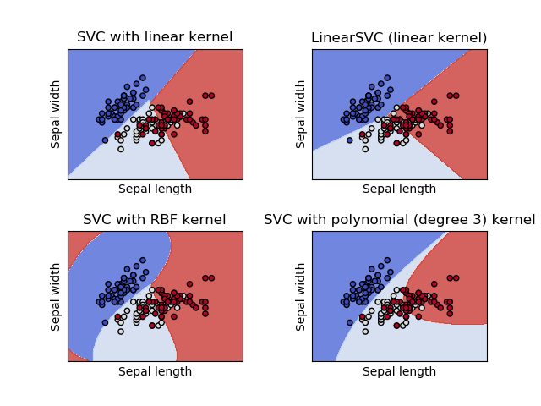
SVM and different Kernels
We can see the different kernels with the iris dataset with two features.
I expected the polynomial kernel to give the best results, but the linear kernel with the C value as 1 gave the best results.
We did 10-fold cross validation with the linear kernel and obtained the following results.
Results:
SVM Precision mean: 0.6295286
SVM Recall mean: 0.902137973
SVM Accuracy mean: 0.77366300

Slide 14
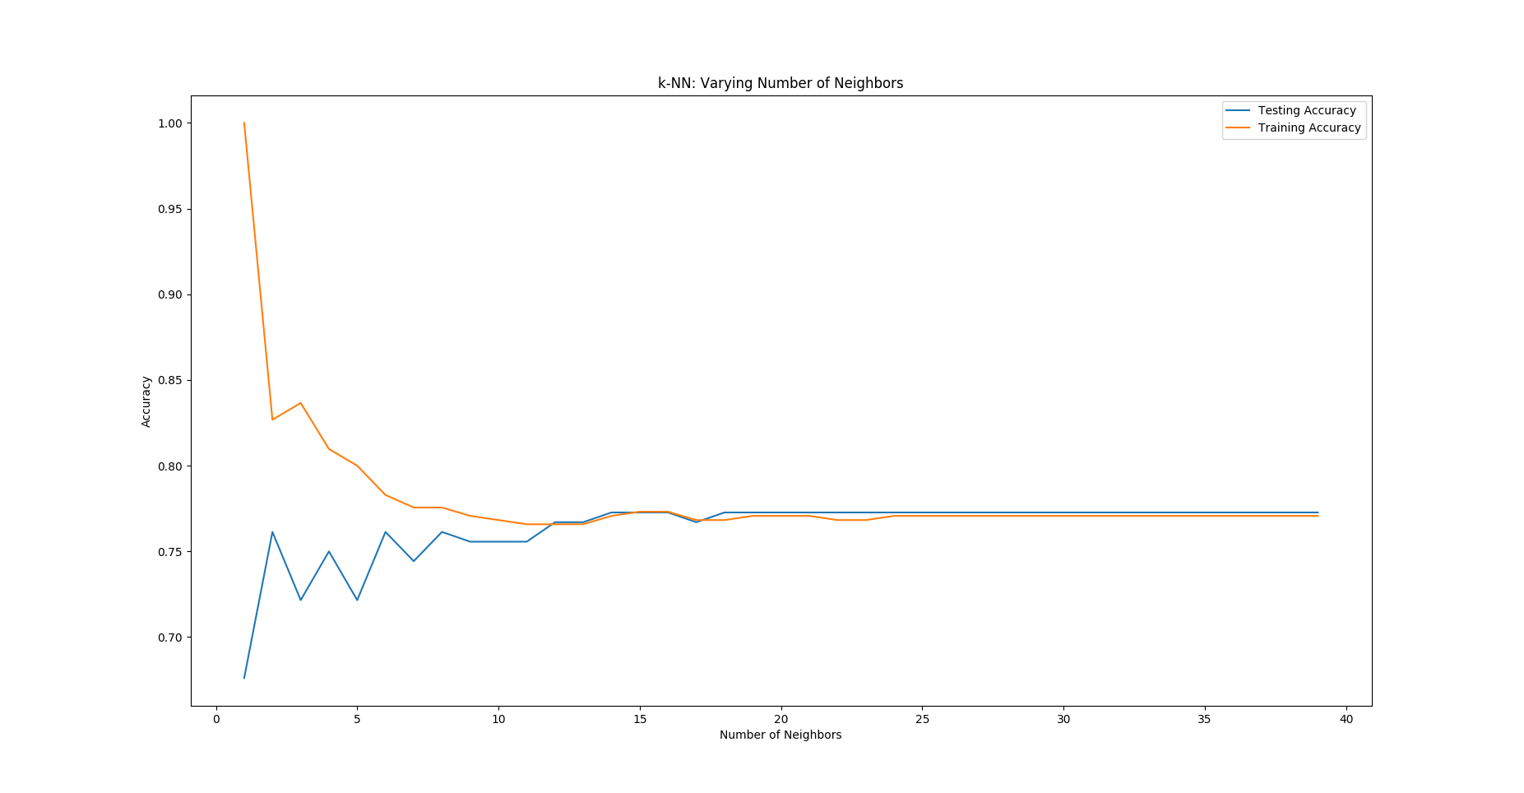
KNN clustering
I looked at KNN accuracy with different number of neighbours from 1 to 40.
I got stable results from 25 clusters and decided to use the SMOTE data to get the best results.
Results:
Accuracy: 0.637681159
Precision: 0.428571428
Recall: 0.260869565217

Slide 15
Future Goals
Following are a few improvements or areas that can be improved.
As there is differential clustering in PCA analysis between races, it would be best to divide the data and try out prediction as to avoid poor performance or accuracy.
We can use the unsupervised sites which we used and try to build a model and try to predict the VACs index rather than poor outcomes.
We can use an Ensemble based model with oversampling the data and look at the results for the model.

Slide 16
References:
Zhang, X., Hu, Y., Aouizerat, B.E. et al. Machine learning selected smoking-associated DNA methylation signatures that predict HIV prognosis and mortality. Clin Epigenet 10, 155 (2018). https://doi.org/10.1186/s13148-018-0591-z
Brown, S. T., Tate, J. P., Kyriakides, T. C., Kirkwood, K. A., Holodniy, M., Goulet, J. L., Angus, B. J., Cameron, D. W., Justice, A. C., & OPTIMA Team (2014). The VACS index accurately predicts mortality and treatment response among multi-drug resistant HIV infected patients participating in the options in management with antiretrovirals (OPTIMA) study. PloS one, 9(3), e92606. https://doi.org/10.1371/journal.pone.0092606
Peters TJ, Buckley MJ, Statham AL, Pidsley R, Samaras K, Lord RV, Clark SJ, Molloy PL (2015). “De novo identification of differentially methylated regions in the human genome.” Epigenetics & Chromatin, 8, 6. http://www.epigeneticsandchromatin.com/content/8/1/6.
Blagus, R., & Lusa, L. (2013). SMOTE for high-dimensional class-imbalanced data. BMC Bioinformatics, 14(1). doi: 10.1186/1471-2105-14-106

Slide 17
Thankyou!

